Slide 1

If there's anything that you would like people to help you spread the word on with social media, this tool might just be the one for you!
Notes:
ZocialRipple is a tool. to find out what kind of content our followers tend to engage with
and create content we know our community will find informative and/or entertaining.

Slide 2
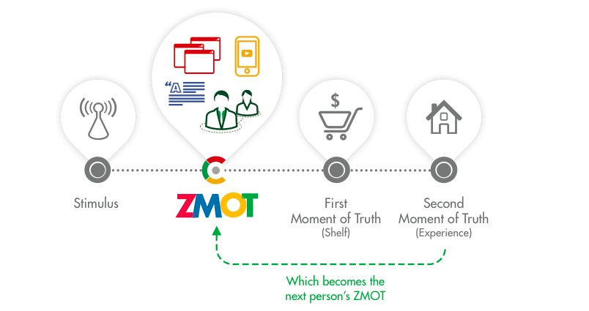
What is your Social Net Worth?
If you are in a social network then you are already an influencer.
Social analytics is fast becoming a key tool for discovering influencers.
The influencer in you is your social net worth.
Notes:
LIN: ZMOT stands for Zocial Moment Of Truth??

Slide 3
Southeast Asia Social Media Advertising Spending
50 Million USD spent on Influencer
33%
Total spending 2013
Reference from www.emarketer.com
Notes:
Should compare 2 year
If we look at market size
LIN: What’s the difference between this and the next slide?

Slide 4
What about the remaining 98%...? What a waste Even as spending increases, CMOs are not integrating Social Media efforts with the rest of their marketing.
Total spending is spent on only 2% of Potential influencer
Notes:
Number is look small but if we se in detail that number is spend only xx% of total potential influencer

Slide 5





Share for reward

Slide 6



Problem
Not reach Target
Can't tracking
Hard to manage reward
“Processes are manual,
time consuming and tedious.”
Notes:
Big problem of Social influencer is Operation
Price is not standard
Message is not virality enough.
Struck with only top influencer and no new commer.
Manually operations have too much procedure

Slide 7
ZocialRipple is Micro influencer marketing platform
New way to use people to advertise brand.

Slide 8
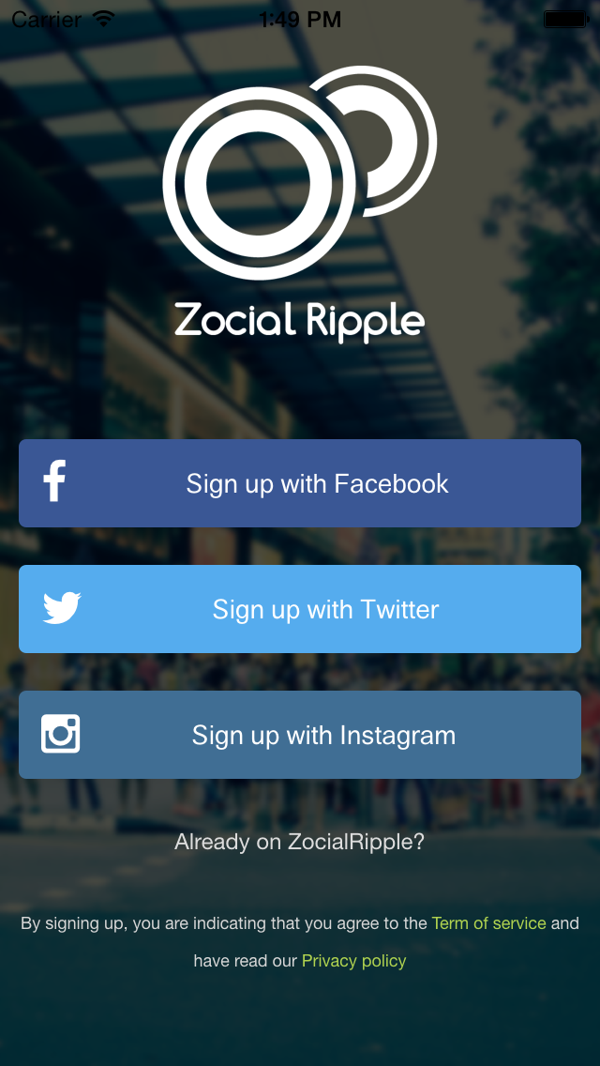
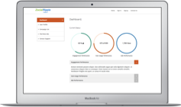
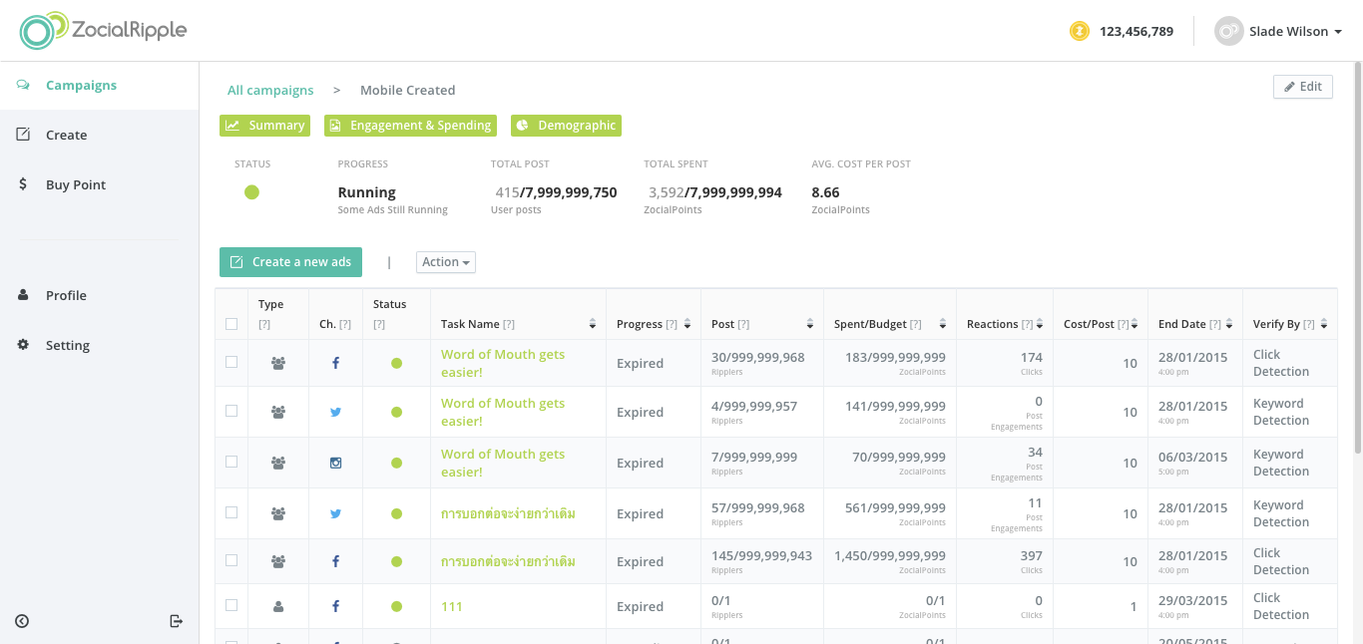
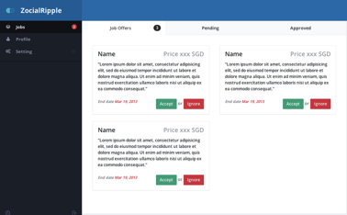
Welcome to ZocialRipple
Rippler (User)
A platform that unleashes the
Influencer in you
Ripplent (Brand)
Social marketing with influencers
Made easy
Notes:
Final Goal

Slide 9

Meet
ERE
Engagement Rating Engine
(A Proprietary Algorithm)
&
Rippler

Slide 10
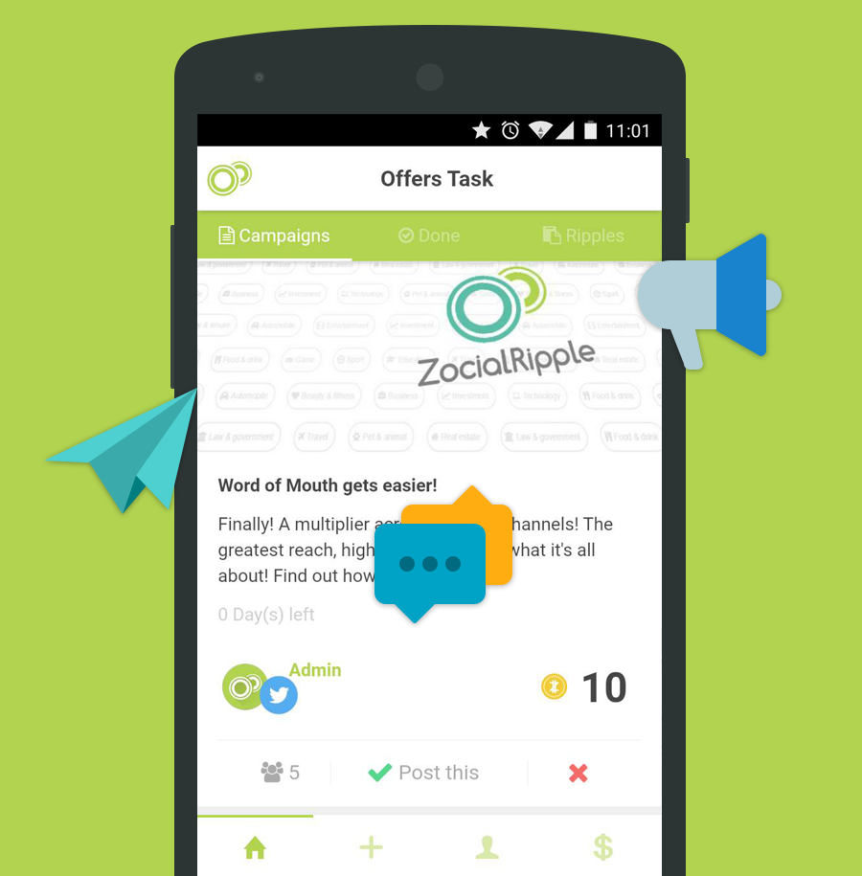
Who’s a Rippler?
Anyone who spreads the word of mouth via ZocialRipple for a cause that he/she supports.

Slide 11
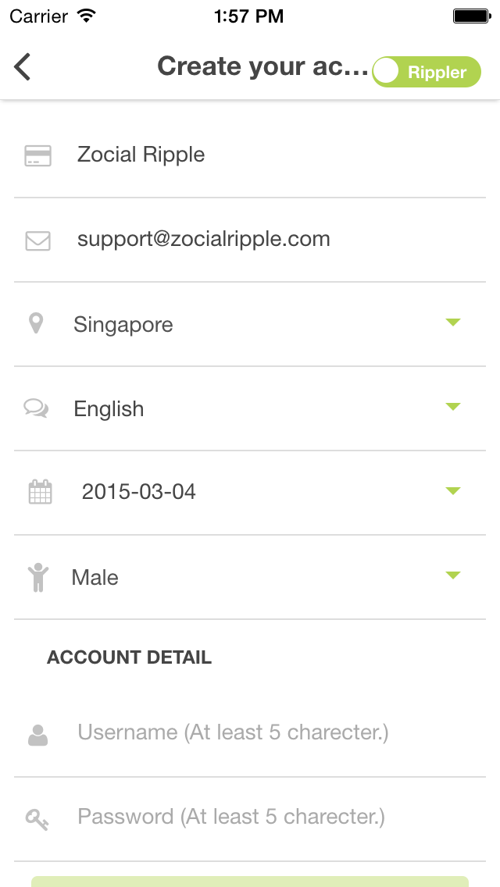
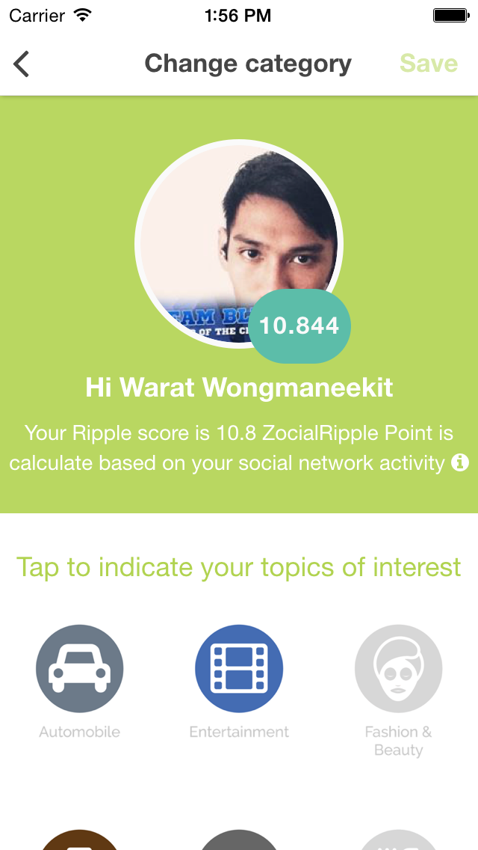
Rippler flow
Login with social network
Adjust your profile
ERE will calculate your Social Engagement Rating Score
And others can discover your
interest and value.

Slide 12
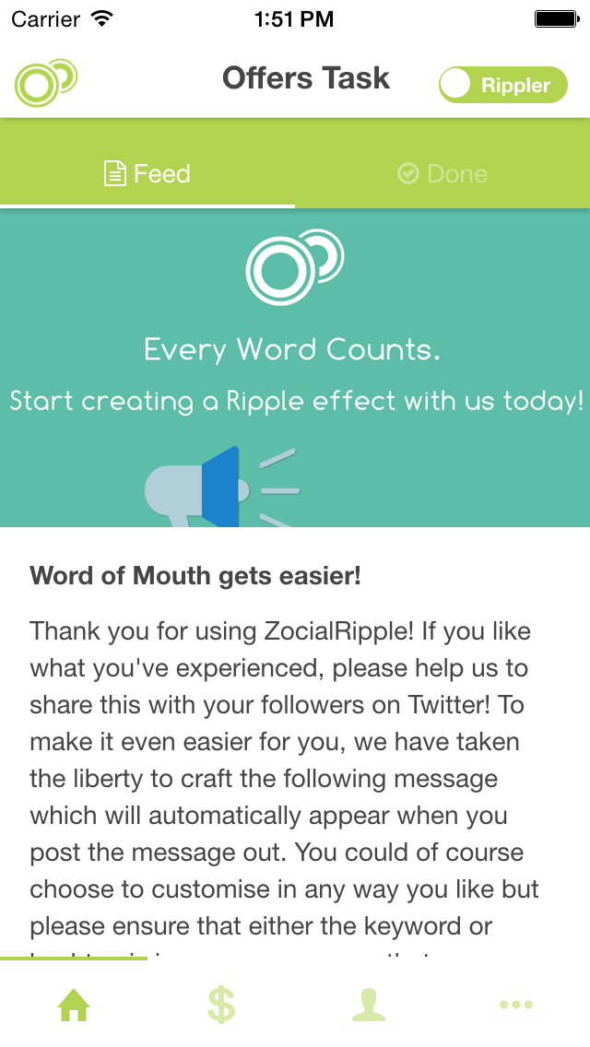
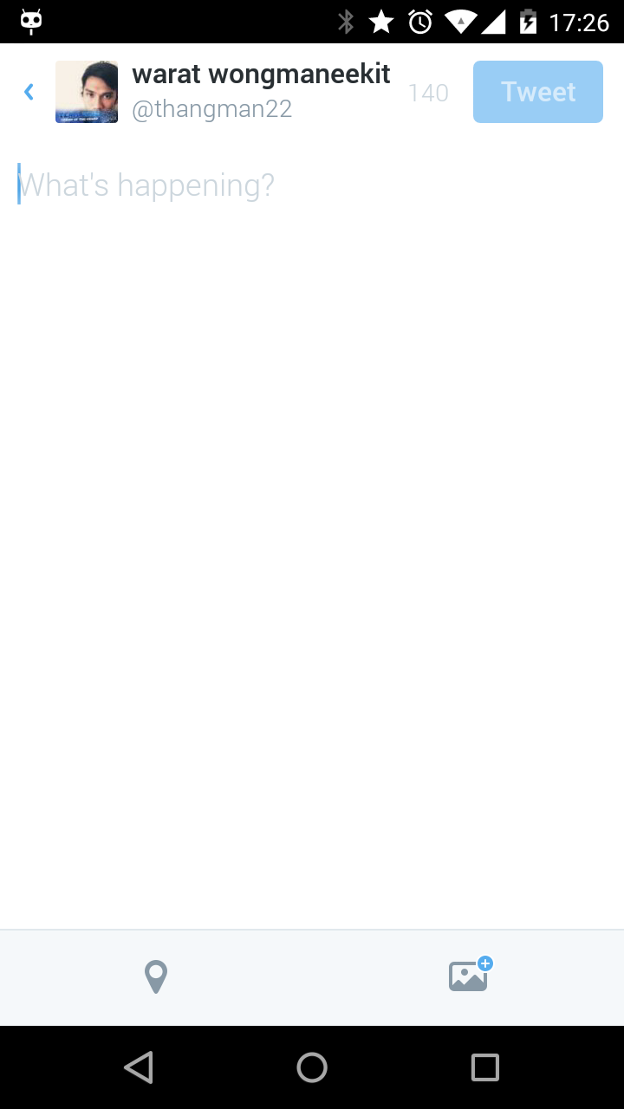
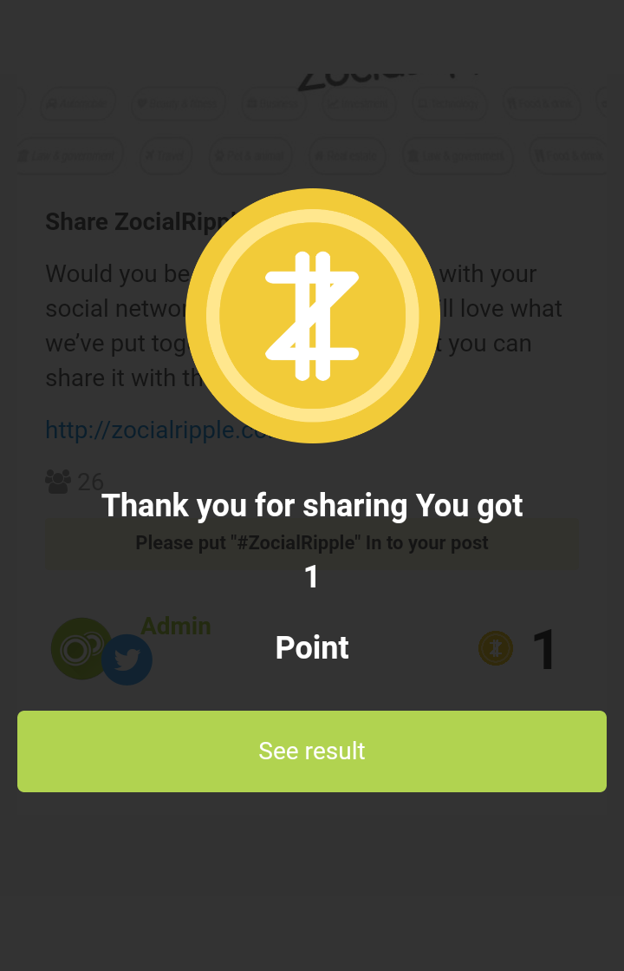
Rippler flow
Accept the task
Post on social network
Receive a Ripple credit or Voucher

Slide 13
Rippler feature
Sharing in main social network
Facebook
Twitter
Instagram
Whatsapp , Line , … (Coming soon)
Rewarded as
Voucher
Point and convert to Gift , Donation

Slide 14
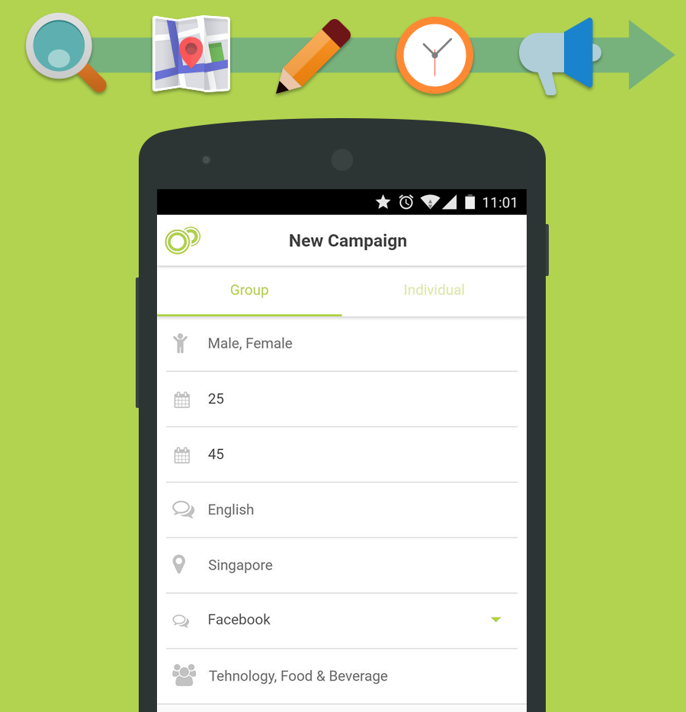
Who’s a Ripplent?
Anyone who wants to reward their Ripplers for spreading the word of mouth.

Slide 15


Ripplent Type
Ripplent Business (Web)
Ripplent Individual (App)

Slide 16
App

Slide 17
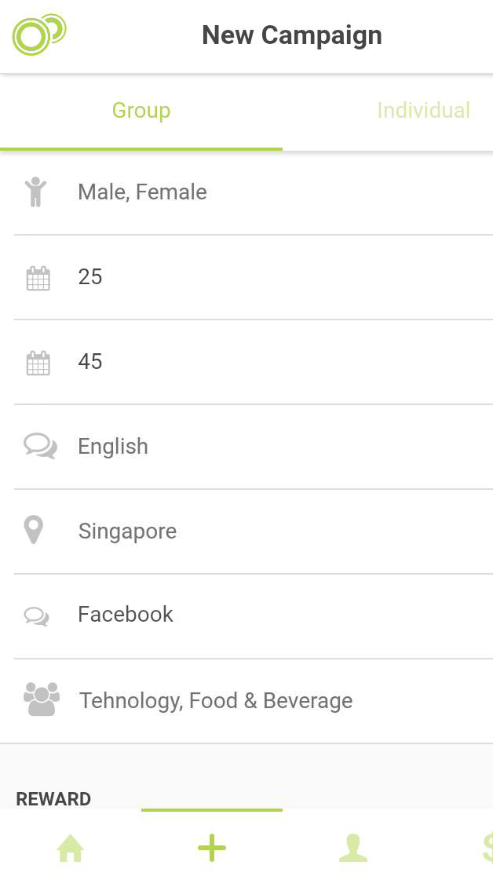
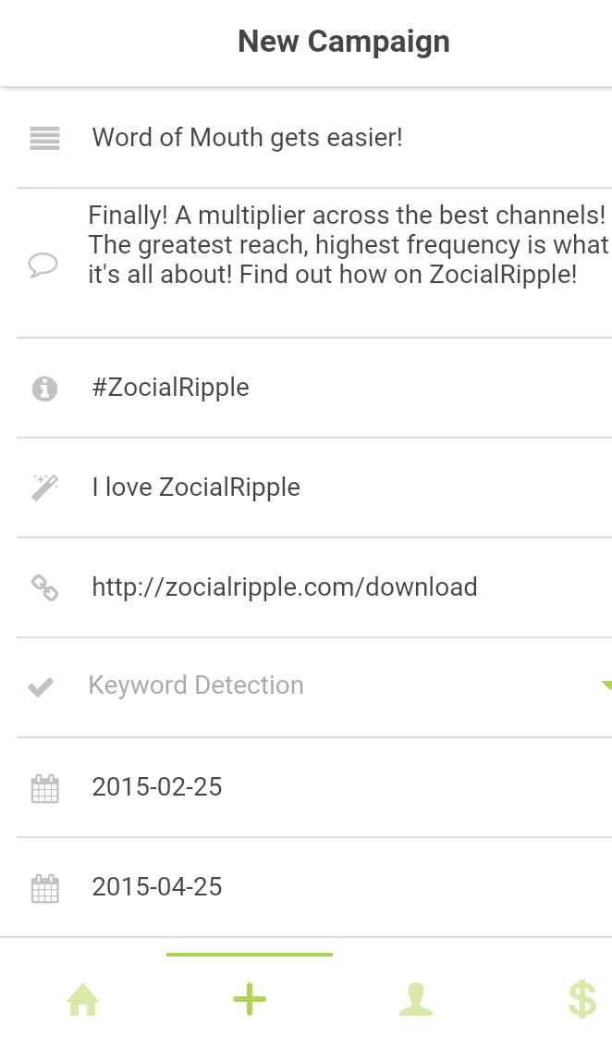
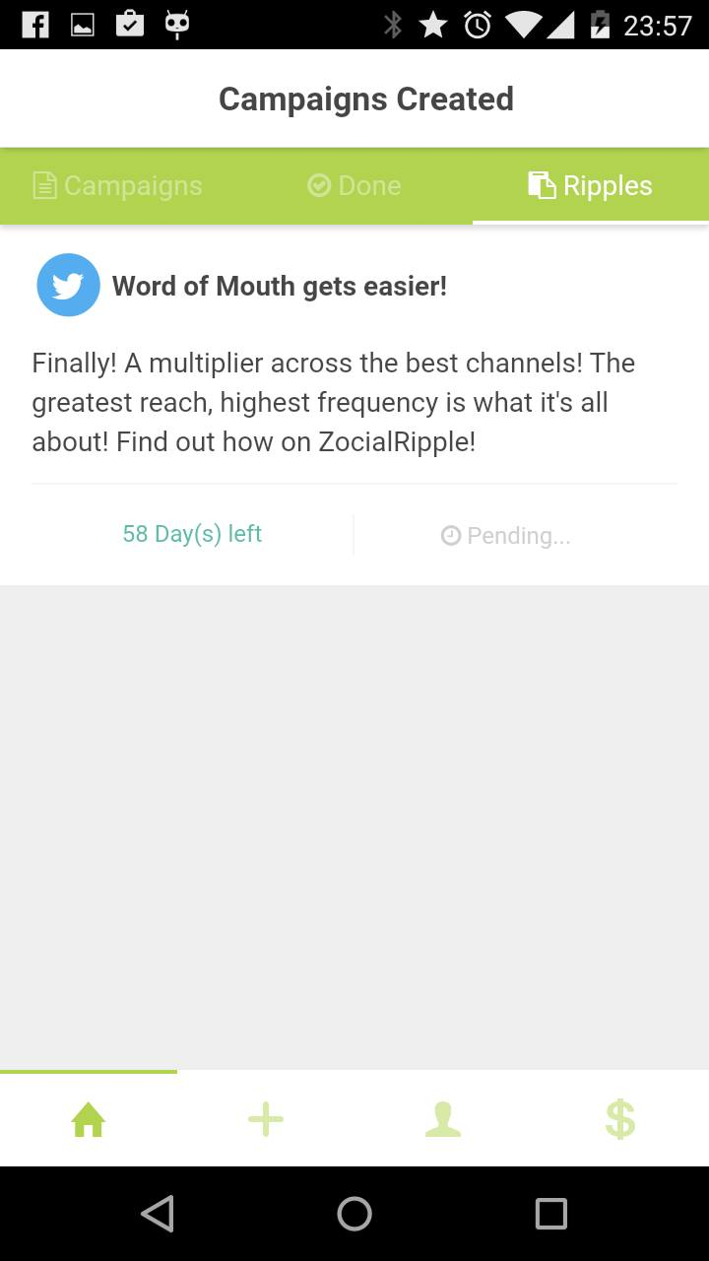
Put target detail or Username
Put task detail
Enjoy your campaign

Slide 18
Website (On Development)

Slide 19
Ripplent feature
Selecting user
By demographic(Age, Gender, Interrest) by ZocialRipple Database
By email list
Private for close event
Detect result
Hashtag (Twitter , Instagram)
Link click (Facebook)
Rewarding
Point (as brand want to give)
Voucher

Slide 20



ZocialRipple Flow
Create advertising
and choose rippler
Rippler Post message
Ripplent See the insight
Pay and receive a ripple point

Slide 21
Benefit for brand
Increase social share of voice.
Promote brand or campaign.
Tracking Word of mount marketing campaign
Deep Analysis demographic of rippler

Slide 22
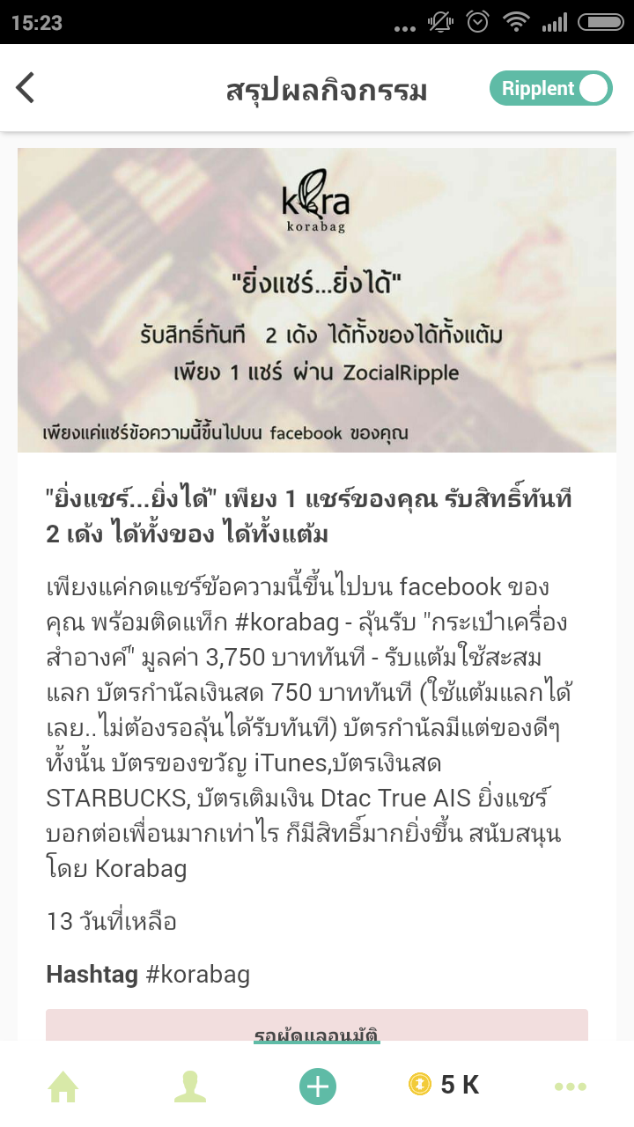
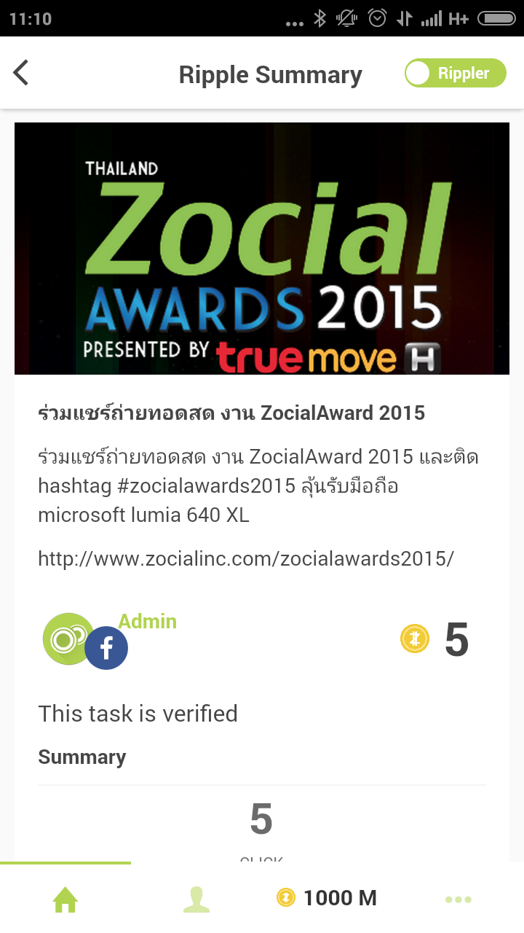
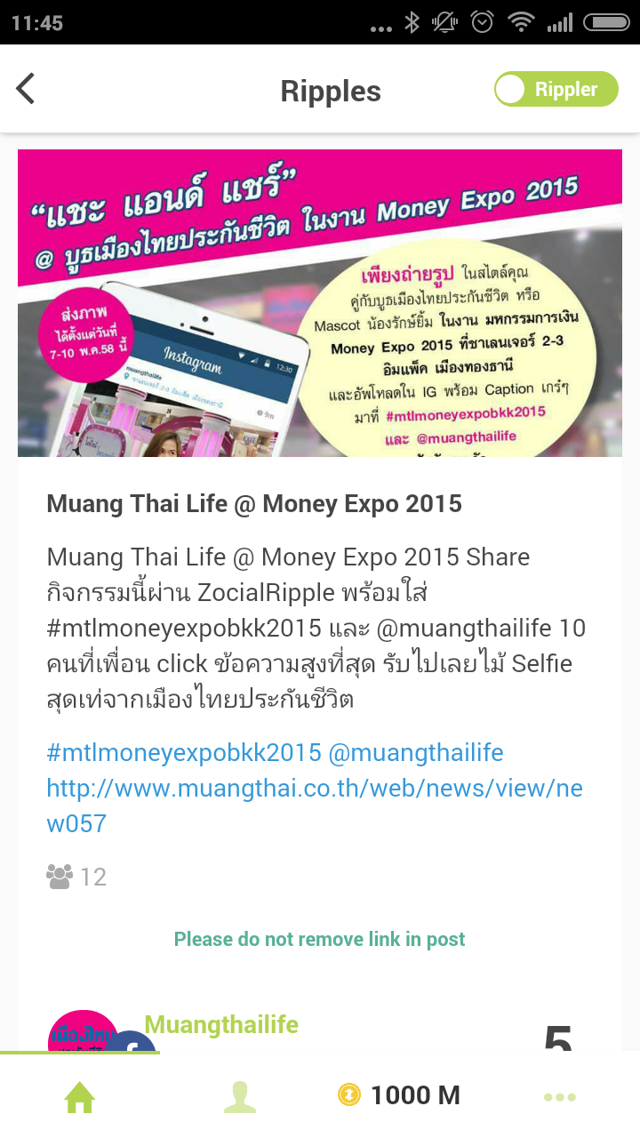
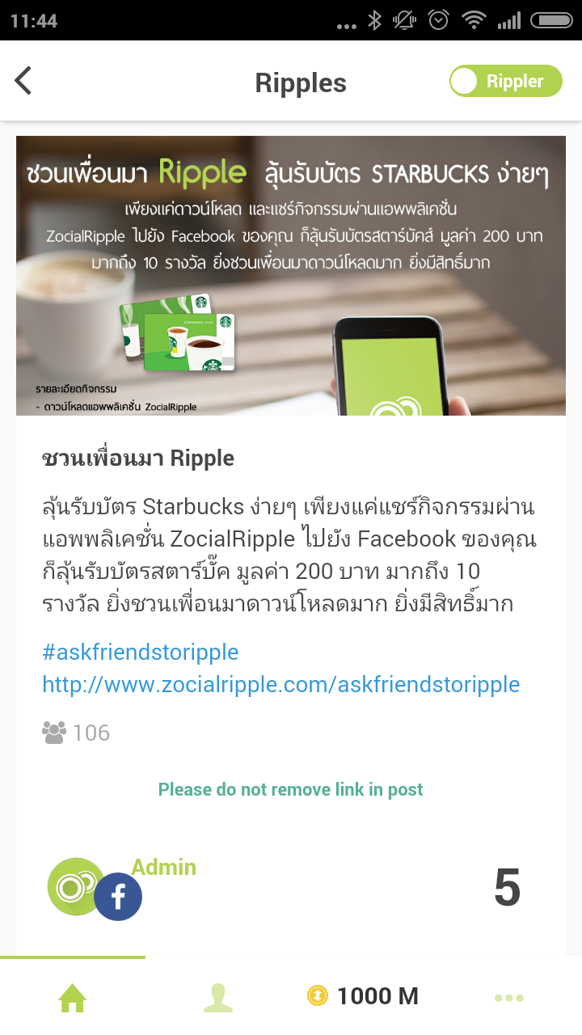
Past campaign

Slide 23
Price
Task type | Value
Rewarded by point | Depend on brand spending
Reward by voucher | 1 point / user
Promotion for early stage For task that assign to email list we offer free 1 point / person
Price (THB) | Discount price (THB) | Points
25,000 | 25,000 | 7,150
50,000 | 49,000 | 14,280
100,000 | 97,000 | 28,500
200,000 | 192,000 | 57,100
300,000 | 285,000 | 85,700

